Slide 1
Inventory Principles

Slide 2


Inventory Norm Principles
P&G DC
Distributor Hub
Distributor Branch
Retailer
Safety stock is calculated basis
Norms for SKUs with higher salience need to be higher
Standard deviation in Lead time from source DC
Truck conversion time and transit time from source DC to distributor site
Factor for service% from DC to distributor (e.g., 90% = 1.28, 95% = 1.64, 99% = 2.33)
SKU average demand
Service Level Factor
Example- Grooming inventory norms are higher for South sites due to higher lead time from Baddi DC

Slide 3
NPI / UPI
&
C-Class Inventory
Concepts, Calculations, Reporting, Analysis and Key Takeaways

Slide 4

NPI : Non-Performing Inventory
Inventory DOH > 180 basis P3M and P6M retailing.
SKU shouldn’t be released in P3M
No N6M demand in P&G forecast
No shipment from P&G to Distributor in P3M
>1000 INR value inv present at Site
To be reported as % of total inventory, To be targeted at <5%

Slide 5
UPI : Under Performing Inventory
Inventory DOH > 90 basis P3M and P6M retailing
SKU shouldn’t be released in P3M
Reported as % of total inventory. To be targeted at <5%

Slide 6
C-Class Inventory
Basis standard ABC analysis method.
C-Class SKUs are the bottom 10% contributing SKUs by business value salience basis P3M/P6M. (A-class is top 70%, B-class is next 20%)
% C-Class inventory is the % inventory by value held by distributor in C-Class SKUs.
Reported as % of total inventory. (Acceptable to be 12-15%)
Can be done at Category level to avoid irregularities.

Slide 7
 | UPI | NPI | C-Class
DOH (basis P3M/P6M) | >90, <180 | >180 | No direct correlation
New Launch | Not launched in P3M | Not launched in P3M | No direct correlation
Shipment history | No correlation | Not shipped in P3M | No direct correlation
Demand forecast | No Correlation | No P&G forecast in N6M | No direct correlation
Business Salience | No correlation | No correlation | Bottom 10% Biz contributing SKUs
Targeted Inventory | <5% of total Inv by value | <5% of total Inv by value | Ideally 12-15% by value
Risk | Medium | High | None; High, if DOH is high

Slide 8
General Guidelines
Should be reported and discussed in-depth during JBP and DLT reviews
Ordering check should be put-in, on the list of these SKUs
Inventory build-ups to be avoided in B&C class SKUs
Inventory on these SKUs should be tracked and highlighted to Sales planning teams for liquidation
Priority for help:
  Liquidate internally – Via focused selling
  If stuck due to external issues like rates/promos – engage with KAM/DTLL & category
  If stuck due to issues like damages/expiries – engage with DTLL for DSDS/Scrapping for all valid reasons

Slide 9

FAQs
SKU is discontinued in MR, what to do?
Was it shipped basis forecast/ Open POs? Can it be sold in other channels? Early signs, Engage CTLL for RMA within good shelf life.
SKU was shipped because of Promo/TPRs, now discontinued.
Always sense check for BUP and tentative promo closure timeline. Engage KAM for next promo timelines, or other liquidation plans.
Low-shelf life stock received, cant be sold.
Engage with DTLL if shipped post P&G SSD. If shipped purely for specific account/ channel with specific requirements, engage with CTLL for RMA. If shelf life is acceptable in other channels, plan retailing accordingly.
Built up for FB, now stuck!
Plan FB shipment basis channel x coverage x hitrates for 40%, and dynamically thereafter. Good to have Sales team buy-in for build-up.

Slide 10
Thank You

Slide 11
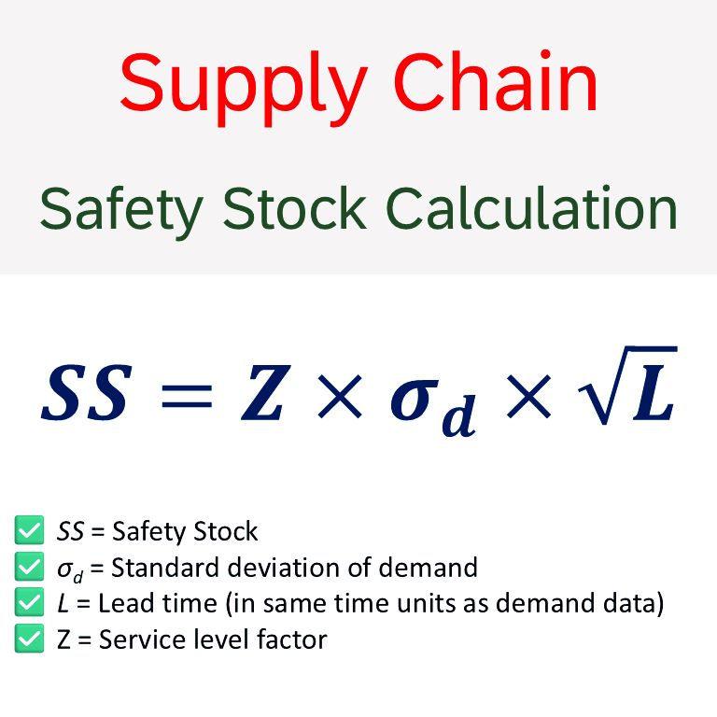

Slide 12
NPI
UPI
C Class
DOH>180
No N6M demand
No shipment from P&G in P3M
2.8 $MM
DOH>90 basis P3M/P6M retailing
4.3 $MM
Bottom 10% contributing SKUs by business
11.6 $MM

